Slide 1
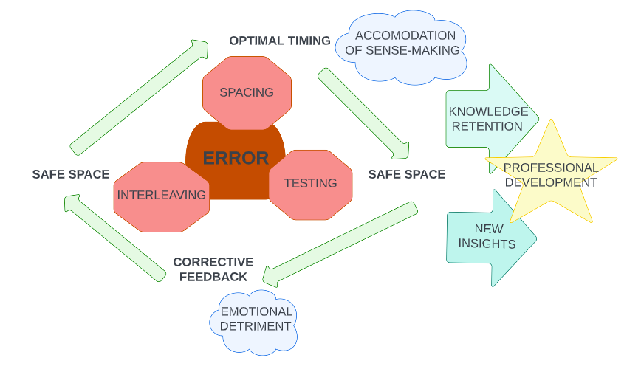
On Error & Difficulty
Giselle Wing Shan Lai
Romulo Jake Montano
Overview
Across multiple education studies, we found investigations into the nature of error, and reframings of what constitutes an error. This yielded surprising results for learning retention and skill-building, as well as perceptions of capability and identity within learners. Addressing error as necessary and useful moments, then situating corrective feedback in a safe environment, led to higher quality learning and enhanced memory malleability. In this way, these researchers suggest that an educational practice that positively regards error-making and difficulty can lead to improved learning experiences.
THE RIGHT WAY TO BE WRONG
Tools & Uses in Practice
TESTING identifies areas of difficulty and opportunity.
PRETESTING guides learner encoding which has been shown to elicit better final performance.
HYPERCORRECTION OF ERRORS learner attention heightens when feedback is given regarding errors made with high confidence (Clarke, 2014).
PRODUCTIVE ERROR a group structure that generates multiple approaches with guidance and analysis after failure leads to higher performance.
SPACING & INTERLEAVING distributing practice over time, allowing for learner to dwell in problem space; revisitation to important material with low-stakes engagement (quizzes, etc.) to assist with retrieval (Clarke, 2014).
Key Assumptions
Error reveals data: There is a condition of “desirable difficulty” where the learner is able to navigate errors through the acquisition process (Clarke, 2014), and once overcome leads to higher-quality recall. Errors also reveal deficiencies in accessibility of the instruction or safety within the learning environment.
Error needs time or feedback: Practices that accommodated both led to more malleability.
Error, or Sense-Making?: What is perceived as an error can be result of instructor’s limited understanding of the learner’s cultural or historical background (Bang, M., et al, 2017).
Contextual Background
Three major areas of focus regarding error-making emerged in our survey of literature, with some overlap. The first investigated the environment and moment in which the error emerged, observing the dynamics of different settings and the emotional responses of learners as they made mistakes (Palominos et al, 2019; Dyre et al, 2022). The second grouping explored the dimensions and efficacy of (corrective) feedback, and the relationship between errors and progress in learning via transfer and malleability tests (Maraver et al, 2022; Clarke, 2014). And finally, the third group investigated the semantics of error conceptually, and what constitutes an error versus sense-making practices (Bang et al, 2017).
Food for Thought
Can you think of an instance when you administered a good form of testing?
How do you regard errors? What culture does your teaching style promote around a learner’s relationship to it?
What student signals do you perceive as healthy sense-making? How do you best determine an opportunity for corrective intervention?
How much time do you allot for yourself and your learners to reflect on and analyze errors?
Growth from Error: Concept Map
References
Bang, M., Brown, B., Calabrese Barton, A., Roseberry, A., Warren, B. (2017). Toward more equitable learning in science: Expanding relationships among students, teachers, and science practices. Helping Students Make Sense of the World Using Next Generation Science and Engineering Practices, 33-58.
Clark, C. Bjork, R. (2014). When and Why Introductin Difficulties and Error can enhance Instruction. Applying the Science of Learning in Education. Psychological Review, 20-30.
Dyre, L., Grierson, L., Rasmussen, K. M. B., Ringsted, C., & Tolsgaard, M. G. (2022). The concept of errors in medical education: a scoping review. Advances in Health Sciences Education, 27(3), 761-792.
Maraver, M. J., Lapa, A., Garcia-Marques, L., Carneiro, P., & Raposo, A. (2022). Can we learn from errors? Retrieval facilitates the correction of false memories for pragmatic inferences. PloS one, 17(8), e0272427.
Palominos, E., Levett-Jones, T., Power, T., & Martinez-Maldonado, R. (2019). Healthcare students' perceptions and experiences of making errors in simulation: An integrative review. Nurse Educ Today, 77, 32-39.
Yang, C., Potts, R., & Shanks, D. R. (2017). Metacognitive unawareness of the errorful generation benefit and its effects on self-regulated learning. J Exp Psychol Learn Mem Cogn, 43(7), 1073-1092.

Slide 2
On Error & Difficulty
Giselle Wing Shan Lai
Romulo Jake Montano
Script for Audio Portion
Intro (Jake):
Hello! Thank you for taking the time to read through our poster. My name is Jake along with my partner Giselle and the topic of our research literature survey is on the role of Errors & Difficulty within learning. Here you’ll find a synthesis of our findings from across several different studies as well as some key takeaways that can be applicable to a wide variety of educational practices. Our goal in conducting this survey of the existing scholarship was to highlight the various parts of what it means to make an error, and how best to regard and respond to instances of error-making, so that improvements and best practices can emerge within any individual pedagogy and perhaps the wider field. As these cited studies all cover settings including classroom learning as well as clinical and simulation settings, it may be useful for you to consider your own environments and learners within your practice while navigating this poster.
Contextual Background (Jake):
In our survey of various texts regarding error and difficulty, we found that researchers were as interested in the semantics and phenomena of an error as to its role within the process of learning. In the category of the former, the semantics and definitions of error-making, we found that researchers distinguished between a lack of learning in ways that were either qualitative or quantitative in nature. Qualitative errors often had to do with the fundamentals of a topic, or the methodology of its practice, whereas quantitative had to do with details, measurements, logical reasoning, and nomenclature. Dyer et al found that this was very dependent on the discipline, but even the environment had an effect on whether one or the other was more immediately identified. And, one way or the other, this shaped the feedback. The emotional composition of the learner making the error was also a subject of study across our survey. Both the Palominos and Maraver studies distinguished between errors made in spaces that felt safe for learners, and those that did not. For Palominos et al, accountability was a necessary component within a safe space, as well as immediate corrective feedback by a trusted instructor, for the experience to be beneficial. The Maraver and Huelser studies found that correction in this way was actually more effective than re-studying the material, or even simply seeing the correct way the first time. Implementing difficulty with intention, through interleaving or segmenting of the content, also allowed for errors to be made functionally, that contributed to the next stages of the instruction or simulation. Across each of these studies, error was a distinct moment reflecting a tension between either the learner and content, the learner and the instructor, or all three to one another, but that careful understanding could lead to optimized learning and better recall and performance. A third category also emerged in our survey that reframed errors as artifacts of a non-inclusive instructional design. Bang et al suggests that the concept of an error may instead be due to a tension in the instructor’s understanding of the learner’s sense-making process. Culling these sources together allows for a clearer understanding of a number of best practices around error-making to improve both learning and instruction.
Food for Thought (Giselle):
+ In this section we wanted to ignite your personal experiences and ideas around error that is used in your teaching and learning practices.
+ Can you think of an instance when you administered a good form of testing? (did it work and what did you use as a measure for success)
+ How do you regard errors? What culture does your teaching style promote around a learner’s relationship to it?
+ What student signals do you perceive as healthy sense-making? How do you best determine an opportunity for corrective intervention?
+ How much time do you allot for yourself and your learners to reflect-on and analyze error? ( what is your threshold to provide corrective feedback and how do you provide it)
Key Assumptions (Jake):
Now that you have considered some questions for your own practice and learning environments, it is important to address some of the assumptions from which our synthesis and suggestions for best practices can be better situated. These key understandings form the fundamentals of the questions, as well as tools, that these researchers pivoted around.
Firstly, and regardless of how any given researcher defined what an error was within the context of the discipline or environment they observed or interacted with, they all arrived at an understanding that errors were revelatory phenomenon that offered critical information about some aspect of learning or instruction. This could mean that instruction or content was missing needed scaffolding, that learners needed more time to practice, that the space or process was overwhelmed by too much ambient detail, or even that relationship dynamics within the space did not accommodate different levels of performance.
Secondly, all of our studies regarded error as only one part of an overall distinct moment or process that also included time or feedback, or both. Just as error provided data, it also required input in order for it to be implemented effectively as a learning moment in the wider process. Reflection, analysis, accountability, feedback, retrials or retesting, and iteration were all things these researchers found to be needed addendums or supplemental to the emergence of the mistake or error in the first place.
And finally, our survey also revealed that the notion of an error was not necessarily fixed with its scope around simply the learners, the content, or the instructor. Errors could be residual of a deeper historical or cultural context, and how the instructional content or facilitation was approached to begin with. This certainly loops back into the first key assumption about the revelation of data, but we felt this deserved its own discussion as this promotes a recurring practice of reflection on what the latent and embedded values are within an organization, practitioner, or pedagogy.
Tools & Uses in Practice (Giselle):
There are a number of practice tools and conditions that can be considered when creating healthy error in the learning environment. We have listed a number of applications that have been cited in the literature and we encourage you to consider these for in your own learning contexts. Thoughtfully adding error to the learning environment requires attention and flexibility. Overall, for error to be a successful tool relies heavily on a commitment from the educator. Surprisingly, when applying hypercorrection of error, Metcalf and Finn noted a better uptake to error recognition and correction when learners were given feedback to the errors that they were more confident about. In small group learning environments, collaborative learning is supported in the structure that is demonstrated with productive error.
A Walkthrough of Our Strategy / Concept Map (Giselle):
A summary of our findings can be found in the concept map. Here we have pulled together practical considerations which have been highlighted in the literature to achieve desirable outcomes for error in learning. We start with error as the core concept which has also been weaved into three practice conditions including spacing, interleaving and testing. Spacing allows errors to surface. With time and space, misconceptions that are clarified by the learner tend to strengthen future understanding and knowledge. Interleaving of mixed media may unintentionally overlap and create confusion, requiring the learner to select key information. This has been shown to strengthen knowledge and memory. Additionally, the test environment strengthens the recall of information and challenges error with correct information. Within each context of error allowance we are asked to consider corrective feedback. It is important to have a timely delivery as memory is most malleable to incite change and be updated when closest to the instance of error. In all opportunities the educator must consider time and space for feedback to be accepted by the learner. Without special consideration we run a risk of emotional detriment in the learner which could affect this experience as well a impact negatively future opportunities for learning. Weaved into timing is the space to allow the learner to make their own learning connections and we highlight this with the accommodation of sense-making. With the cycle of error in operation, we aim for the desirable outcomes of knowledge retention for the learner and generation of new insights for the educator. Both yielding growth and professional development.
Conclusive Thoughts (Giselle):
Errorful learning suggests that learning can be continuous and fluid when considered accurately. Errors can enhance future learning when followed by timely corrective feedback. As shown in a number of studies, learning strategies that engage in active and explicit retrieval, even if the retrieved information is wrong, when provided with immediate feedback memory updating is promoted and errors are more likely to be corrected with ease and attain long term retention.

